Slide 1
Chapter 1:
Introduction

Slide 2
Computers for the next decades?
Computers are integrated
  small, cheap, portable, replaceable - no more separate devices
Technology is in the background
  computer are aware of their environment and adapt (“location awareness”)
  computer recognize the location of the user and react appropriately (e.g., call forwarding, fax forwarding, “context awareness”))
Advances in technology
  more computing power in smaller devices
  flat, lightweight displays with low power consumption
  new user interfaces due to small dimensions
  more bandwidth per cubic meter
  multiple wireless interfaces: wireless LANs, wireless WANs, regional wireless telecommunication networks etc. („overlay networks“)

Slide 3
Mobile communication
Two aspects of mobility:
  user mobility: users communicate (wireless) “anytime, anywhere, with anyone”
  device portability: devices can be connected anytime, anywhere to the network
Wireless vs. mobile Examples
✗ ✗ stationary computer
✗ ✓ notebook in a hotel
✓ ✗ wireless LANs in historic buildings
✓ ✓ Personal Digital Assistant (PDA)
The demand for mobile communication creates the need for integration of wireless networks into existing fixed networks:
  local area networks: standardization of IEEE 802.11,
  ETSI (HIPERLAN)
  Internet: Mobile IP extension of the internet protocol IP
  wide area networks: e.g., internetworking of GSM and ISDN

Slide 4
Applications I
Vehicles
  transmission of news, road condition, weather, music via DAB
  personal communication using GSM
  position via GPS
  Remote areas – Satellite Communications
  local ad-hoc network with vehicles close-by to prevent accidents, guidance system, redundancy
  vehicle data (e.g., from busses, high-speed trains) can be transmitted in advance for maintenance
Emergencies
  early transmission of patient data to the hospital, current status, first diagnosis
  replacement of a fixed infrastructure in case of earthquakes, hurricanes, fire etc.
  crisis, war, ...

Slide 5
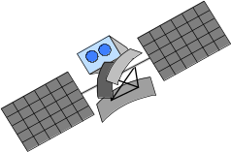
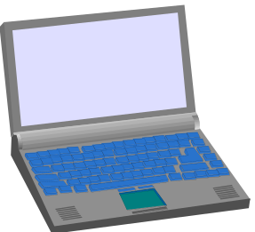

Typical application: road traffic
UMTS, WLAN,
DAB, GSM,
cdma2000, TETRA, ...
ad hoc
Personal Travel Assistant,
DAB, PDA, laptop,
GSM, UMTS, WLAN,
Bluetooth, ...

Slide 6







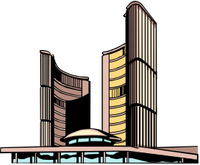
Mobile and wireless services – Always Best Connected
UMTS, GSM
115 kbit/s
LAN
100 Mbit/s,
WLAN
54 Mbit/s
LAN, WLAN
780 kbit/s
GSM 53 kbit/s
Bluetooth 500 kbit/s
UMTS,
DECT
2 Mbit/s
GSM/EDGE 384 kbit/s,
WLAN 780 kbit/s
UMTS, GSM
384 kbit/s
GSM 115 kbit/s,
WLAN 11 Mbit/s

Slide 7

Applications II
Travelling salesmen
  direct access to customer files stored in a central location
  consistent databases for all agents
  mobile office
Replacement of fixed networks
  remote sensors, e.g., weather, earth activities
  flexibility for trade shows
  WLANs in historic buildings
Entertainment, education, ...
  outdoor Internet access
  intelligent travel guide with up-to-date
  location dependent information
  ad-hoc networks for
  multi user games
History
Info

Slide 8
Location dependent services
Location aware services
  what services, e.g., printer, fax, phone, server etc. exist in the local environment
Follow-on services
  automatic call-forwarding, transmission of the actual workspace to the current location
Information services
  „push“: e.g., current special offers in the supermarket
  „pull“: e.g., where is the Black Forrest Cherry Cake?
Support services
  caches, intermediate results, state information etc. „follow“ the mobile device through the fixed network
Privacy
  who should gain knowledge about the location

Slide 9
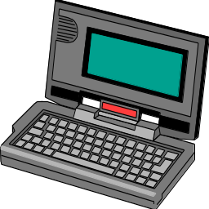

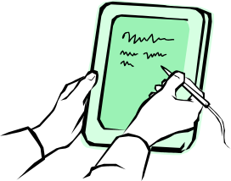
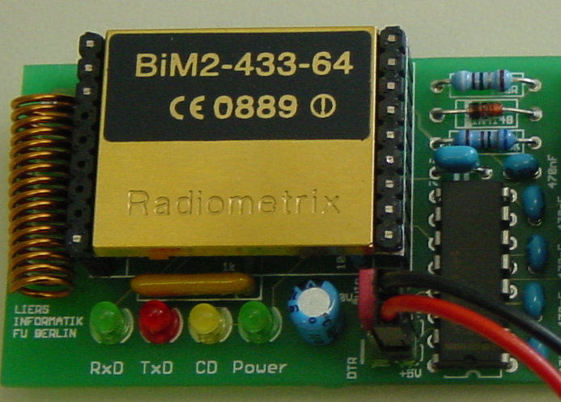
Mobile devices
Pager
receive only
tiny displays
simple text
messages
PDA
simpler graphical displays
character recognition
simplified WWW
Laptop
fully functional
standard applications
Sensors,
embedded
controllers
Mobile phones
voice, data
simple graphical displays
Palmtop
tiny keyboard
simple versions
of standard applications
performance

Slide 10
Effects of device portability
Power consumption
  limited computing power, low quality displays, small disks due to limited battery capacity
  CPU: power consumption ~ CV²f
    C: internal capacity, reduced by integration
    V: supply voltage, can be reduced to a certain limit
    f: clock frequency, can be reduced temporally
Loss of data
  higher probability, has to be included in advance into the design (e.g., defects, theft)
Limited user interfaces
  compromise between size of fingers and portability
  integration of character/voice recognition, abstract symbols
Limited memory
  limited value of mass memories with moving parts
  flash-memory or ? as alternative

Slide 11
Wireless networks in comparison to fixed networks
Higher loss-rates due to interference
  emissions of, e.g., engines, lightning
Restrictive regulations of frequencies
  frequencies have to be coordinated, useful frequencies are almost all occupied
Low transmission rates
  local some Mbit/s, regional currently, e.g., 9.6kbit/s with GSM
Higher delays, higher jitter
  connection setup time with GSM in the second range, several hundred milliseconds for other wireless systems
Lower security, simpler active attacking
  radio interface accessible for everyone, base station can be simulated, thus attracting calls from mobile phones
Always shared medium
  secure access mechanisms important

Slide 12
Simple OSI reference model for mobile communications
Application
Application
Transport
Transport
Network
Network
Network
Network
Data Link
Data Link
Data Link
Data Link
Physical
Physical
Physical
Physical
Radio
Medium

Slide 13
Influence of mobile communication to the layer model
Application layer
Transport layer
Network layer
Data link layer
Physical layer
  service location
  new applications, multimedia
  adaptive applications
  congestion and flow control
  quality of service
  addressing, routing,
  device location
  hand-over
  authentication
  media access
  multiplexing
  media access control
  encryption
  modulation
  interference
  attenuation
  frequency

Slide 14
Physical layer: This is the lowest layer in a communication system and is responsible for the conversion of a stream of bits into signals that can be transmitted on the sender side. The physical layer of the receiver then transforms the signals back into a bit stream. For wireless communication, the physical layer is responsible for frequency selection, generation of the carrier frequency, signal detection modulation of data onto a carrier frequency and encryption
Data link layer: The main tasks of this layer include accessing the medium, multiplexing of different data streams, correction of transmission errors, and synchronization (i.e., detection of a data frame).
Network layer: This third layer is responsible for routing packets through a network or establishing a connection between two entities over many other intermediate systems.
Transport layer: This layer is used in the reference model to establish an end-to-end connection.
Application layer: Finally, the applications (complemented by additional layers that can support applications) are situated on top of all transmissionori ented layers.

